Slide 1
Arithmetic assignment and operators precedence
Programming Fundamentals (CSC103)
Lecture 5
Instructor: Yasher Ali

Slide 2
Table of Contents
Logical Operators
Assignment Operators
Bitwise Operators
Precedence of Operators
Examples

Slide 3
Logical Operators
Following table shows all the logical operators supported by C language. Assume variable A holds 1 and variable B holds 0, then:
Operator | Description | Example
&& | Called Logical AND operator. If both the operands are non-zero, then the condition becomes true. | (A && B) is false.
|| | Called Logical OR Operator. If any of the two operands is non-zero, then the condition becomes true. | (A || B) is true.
! | Called Logical NOT Operator. It is used to reverse the logical state of its operand. If a condition is true, then Logical NOT operator will make it false. | !(A && B) is true.

Slide 4
Assignment Operators
Operator | Description | Example
= | Simple assignment operator. Assigns values from right side operands to left side operand | C = A + B will assign the value of A + B to C
+= | Add AND assignment operator. It adds the right operand to the left operand and assign the result to the left operand. | C += A is equivalent to C = C + A
-= | Subtract AND assignment operator. It subtracts the right operand from the left operand and assigns the result to the left operand. | C -= A is equivalent to C = C - A
*= | Multiply AND assignment operator. It multiplies the right operand with the left operand and assigns the result to the left operand. | C *= A is equivalent to C = C * A
/= | Divide AND assignment operator. It divides the left operand with the right operand and assigns the result to the left operand. | C /= A is equivalent to C = C / A
%= | Modulus AND assignment operator. It takes modulus using two operands and assigns the result to the left operand. | C %= A is equivalent to C = C % A

Slide 5
Bitwise Operators 1
Bitwise operator works on bits and perform bit-by-bit operation. The truth tables for &, |, and ^ is as follows −
p | q | p & q | p | q | p ^ q
0 | 0 | 0 | 0 | 0
0 | 1 | 0 | 1 | 1
1 | 1 | 1 | 1 | 0
1 | 0 | 0 | 1 | 1

Slide 6
Bitwise Operators 2
Assume A = 60 and B = 13 in binary format, they will be as follows −
A = 0011 1100
B = 0000 1101
-----------------
A&B = 0000 1100
A|B = 0011 1101
A^B = 0011 0001
~A = 1100 0011

Slide 7
Bitwise Operators 3
The following table lists the bitwise operators supported by C. Assume variable 'A' holds 60 and variable 'B' holds 13, then:
Operator | Description | Example
& | Binary AND Operator copies a bit to the result if it exists in both operands. | (A & B) = 12, i.e., 0000 1100
| | Binary OR Operator copies a bit if it exists in either operand. | (A | B) = 61, i.e., 0011 1101
^ | Binary XOR Operator copies the bit if it is set in one operand but not both. | (A ^ B) = 49, i.e., 0011 0001
~ | Binary One's Complement Operator is unary and has the effect of 'flipping' bits. | (~A ) = ~(60), i.e,. -0111101
<< | Binary Left Shift Operator. The left operands value is moved left by the number of bits specified by the right operand. | A << 2 = 240 i.e., 1111 0000
>> | Binary Right Shift Operator. The left operands value is moved right by the number of bits specified by the right operand. | A >> 2 = 15 i.e., 0000 1111

Slide 8

Arithmetic expressions in straight-line form
Arithmetic expressions in C must be written in straight-line form to facilitate entering programs into the computer. Thus, expressions such as “a divided by b” must be written as a/b so that all operators and operands appear in a straight line.
The algebraic notation.is generally not acceptable to compilers,
Parentheses for Grouping Subexpressions
Parentheses are used in C expressions in the same manner as in algebraic expressions. For example, to multiply a times the quantity b + c we write a * ( b + c ).

Slide 9

Rules of Operator Precedence 1
C applies the operators in arithmetic expressions in a precise sequence determined by the following rules of operator precedence, which are generally the same as those in algebra:
Rules
Operators in expressions contained within pairs of parentheses are evaluated first.
Parentheses are said to be at the “highest level of precedence.” In cases of nested, or embedded, parentheses, such as
the operators in the innermost pair of parentheses are applied first.

Slide 10
Rules of Operator Precedence 2
Multiplication, division and remainder operations are applied next. If an expression contains several multiplication, division and remainder operations, evaluation proceeds from left to right. Multiplication, division and remainder are said to be on the same level of precedence.
Addition and subtraction operations are evaluated next. If an expression contains several addition and subtraction operations, evaluation proceeds from left to right.
The assignment operator (=) is evaluated last.

Slide 11
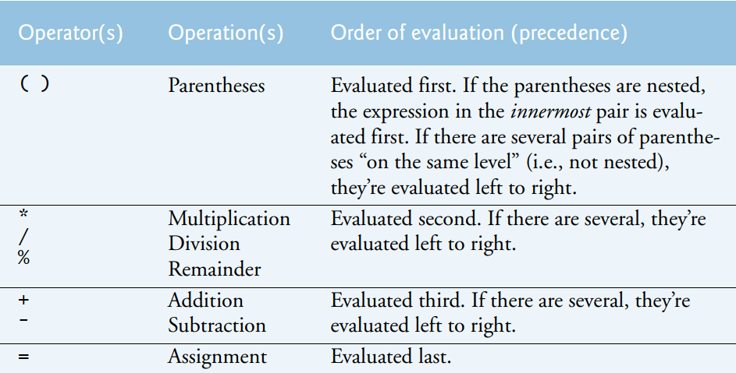
Rules of Operator Precedence 3

Slide 12
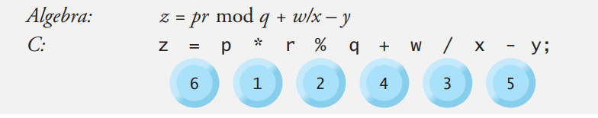
Sample algebraic and C expressions
The circled numbers indicate the order in which C evaluates the operators.
The multiplication, remainder and division are evaluated first in left-to-right order (i.e., they associate from left to right) because they have higher precedence than addition and subtraction.
The addition and subtraction are evaluated next.
They’re also evaluated left to right.
Finally, the result is assigned to the variable z.

Slide 13
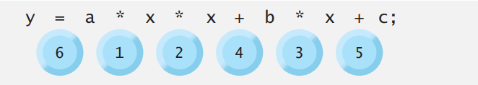
Evaluation of a Second-Degree Polynomial
To develop a better understanding of the rules of operator precedence, let’s see how C evaluates a second-degree polynomial.
There’s no arithmetic operator for exponentiation in C, so we’ve represented x2 as x * x.
The C Standard Library includes the pow (“power”) function to perform exponentiation.

Slide 14
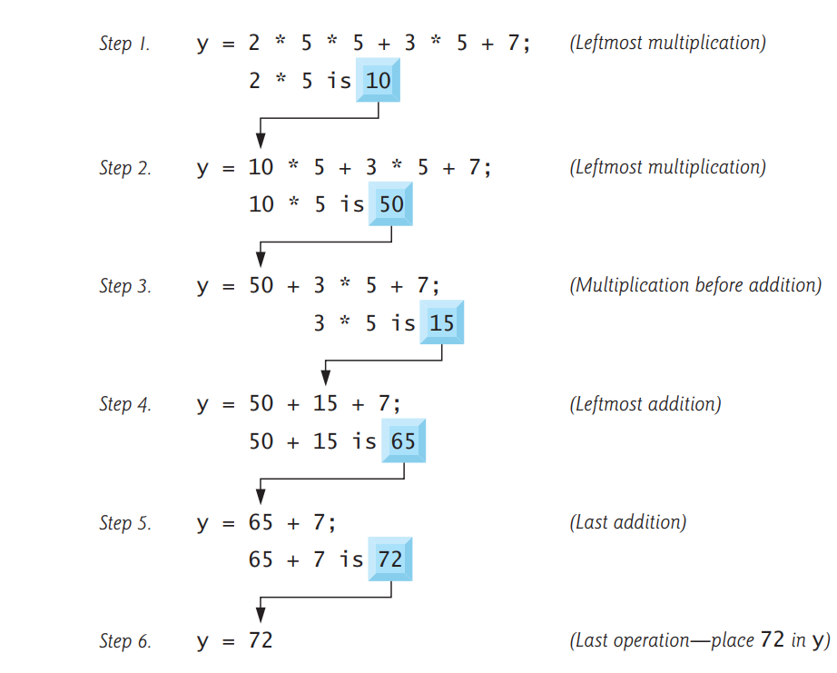
Example:

